Slide 1
Optimizing Foster Care Visitation Scheduling
Erhun Kundakcıoğlu
Özyeğin University
joint work with Shima Azizi, Caroline Johnston,
Andrew Trapp (WPI), and Enes Tanrıkulu (KU)

Slide 2
Foster Care
A temporary service for children who are unable to live with their biological parent(s)
Provides a stable family environment for children
Biological parents work with a social worker to stabilize their situation
More than 368,500 children live in foster care settings in the U.S.*
Periodic meetings
Public spot, ~30-180 minutes
Supervised/unsupervised
All kids must be present (same vehicle)
* U.S. Department of Health and Human Services, The Adoption and Foster Care Analysis and Reporting System, 2023.
Notes:
Depending on the crime

Slide 3
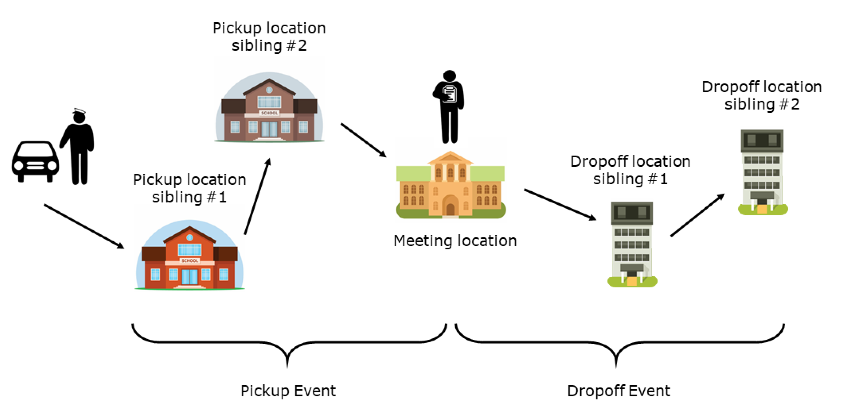
Foster Care Visitation
Maximize the number of cases visited with available workforce,
with a preference for shorter routes to enhance efficiency
Origin locations
Lunch breaks
Driver or CWA
Time restrictions
Varying locations
Cannot be combined
Never wait
Notes:
• There is a set of pre-determined locations:
Start garages for the caseworkers
Pickup and dropoff locations for the children
Meeting locations
• Children from different cases cannot be in the same vehicle
• During the meeting, the driver may service another case

Slide 4
Research Questions
How can a decision support tool, supported by an advanced mathematical optimization model, improve foster care visitation scheduling by balancing efficiency and adaptability to real-time challenges?
How can the foster care visitation scheduling process be optimized to strengthen child-parent connections, given real-world constraints such as court-mandated supervision, diverse case locations, and limited availability of case workers?
What impact do varying visitation schedules and consistent driver assignments have on the workforce, and how might optimized scheduling practices reduce burnout while promoting fairness among caseworkers?

Slide 5
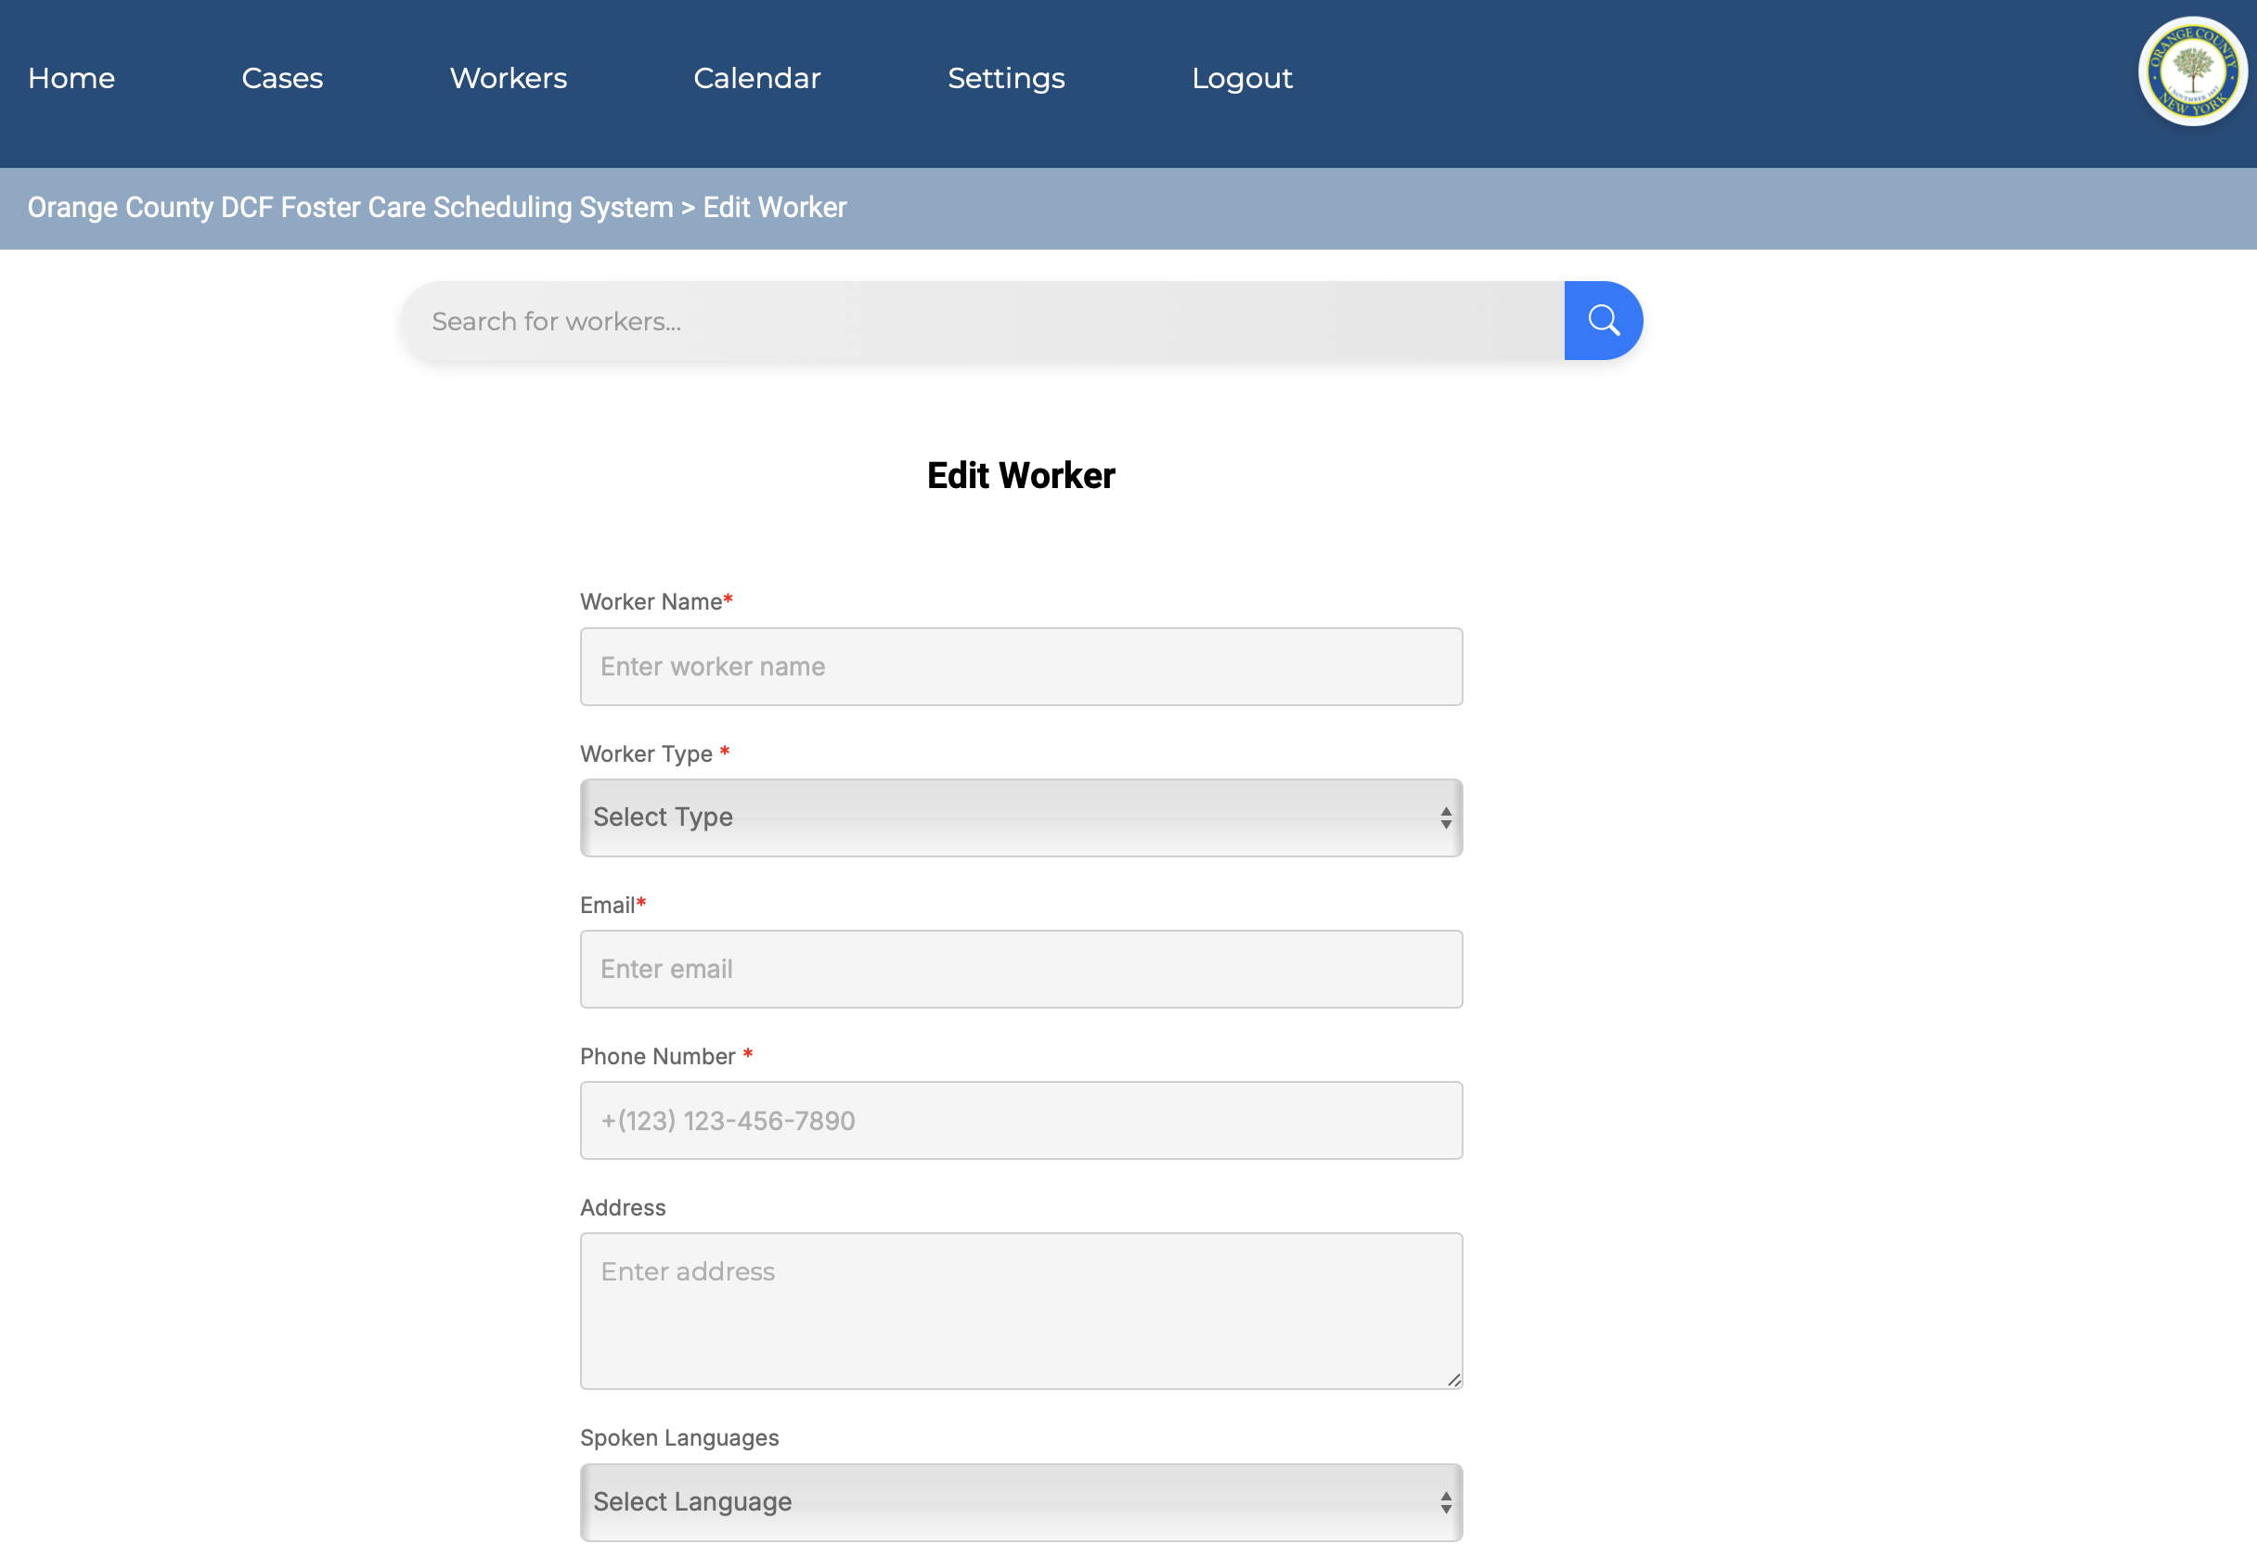
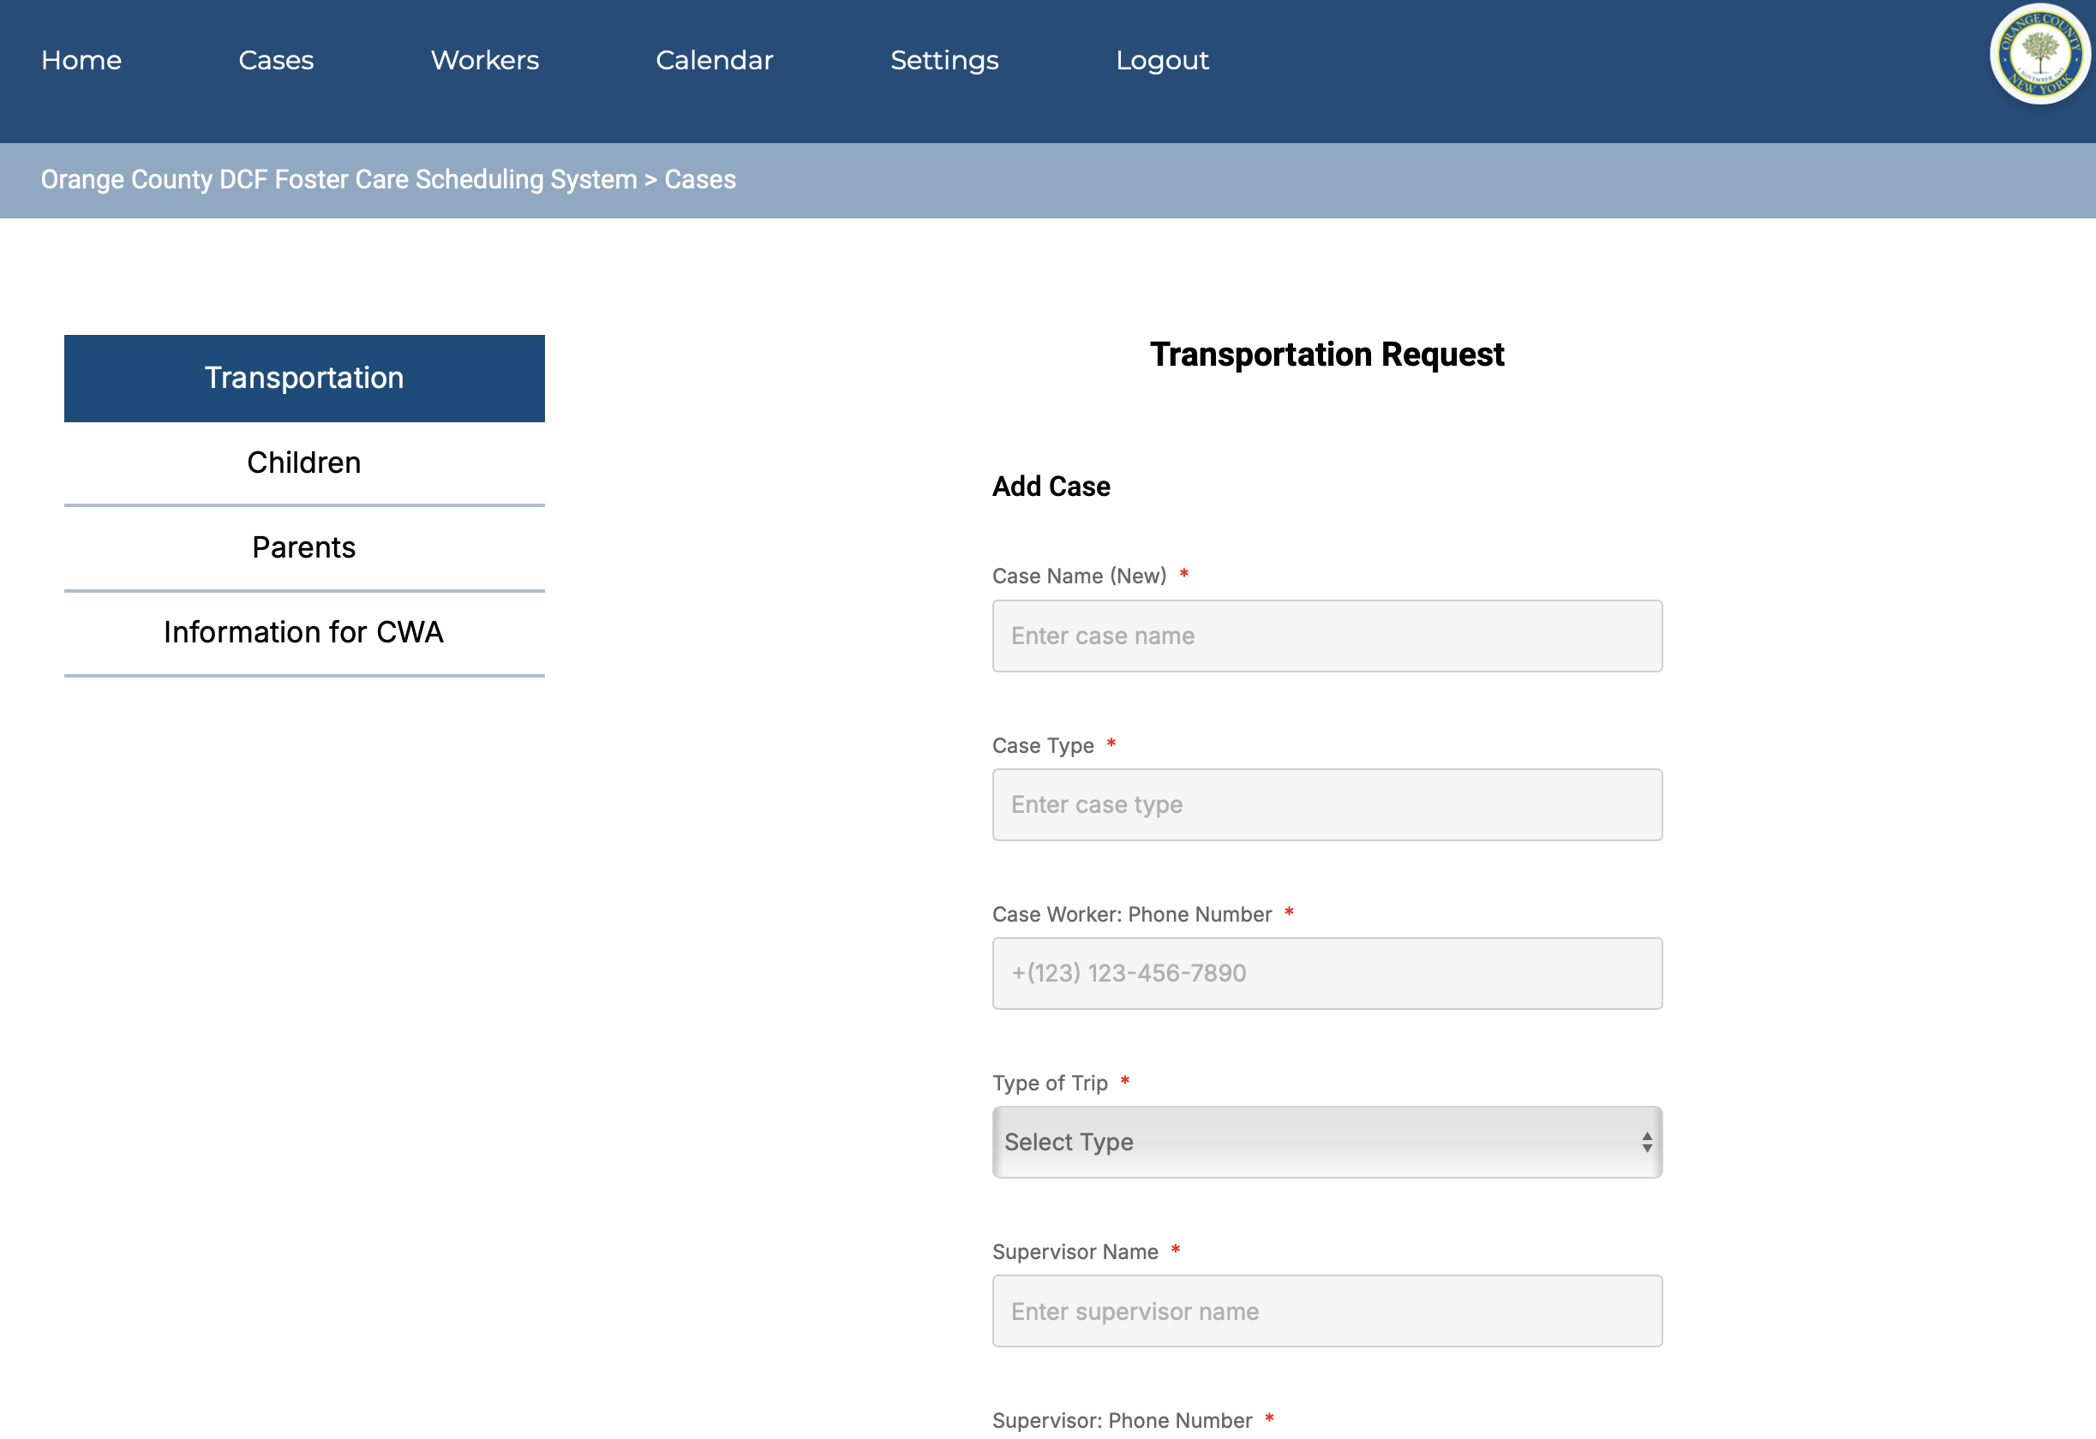
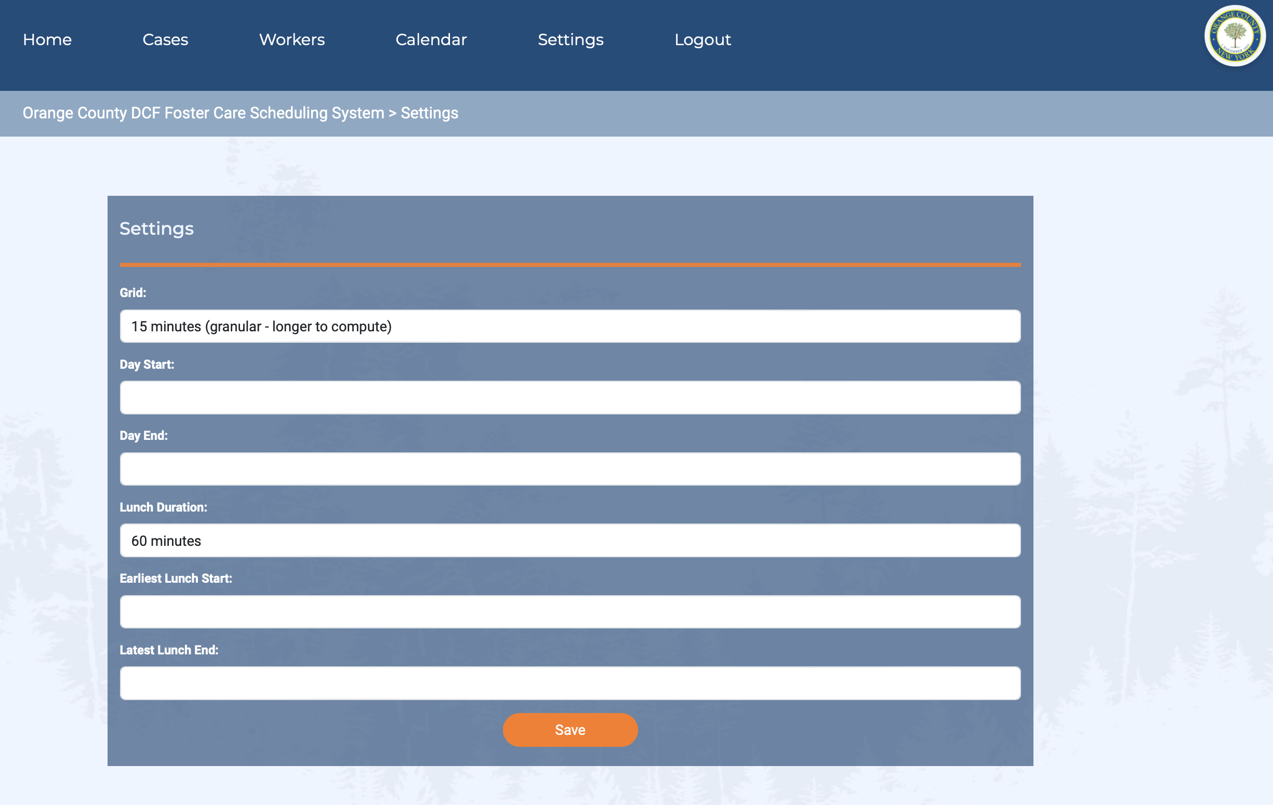
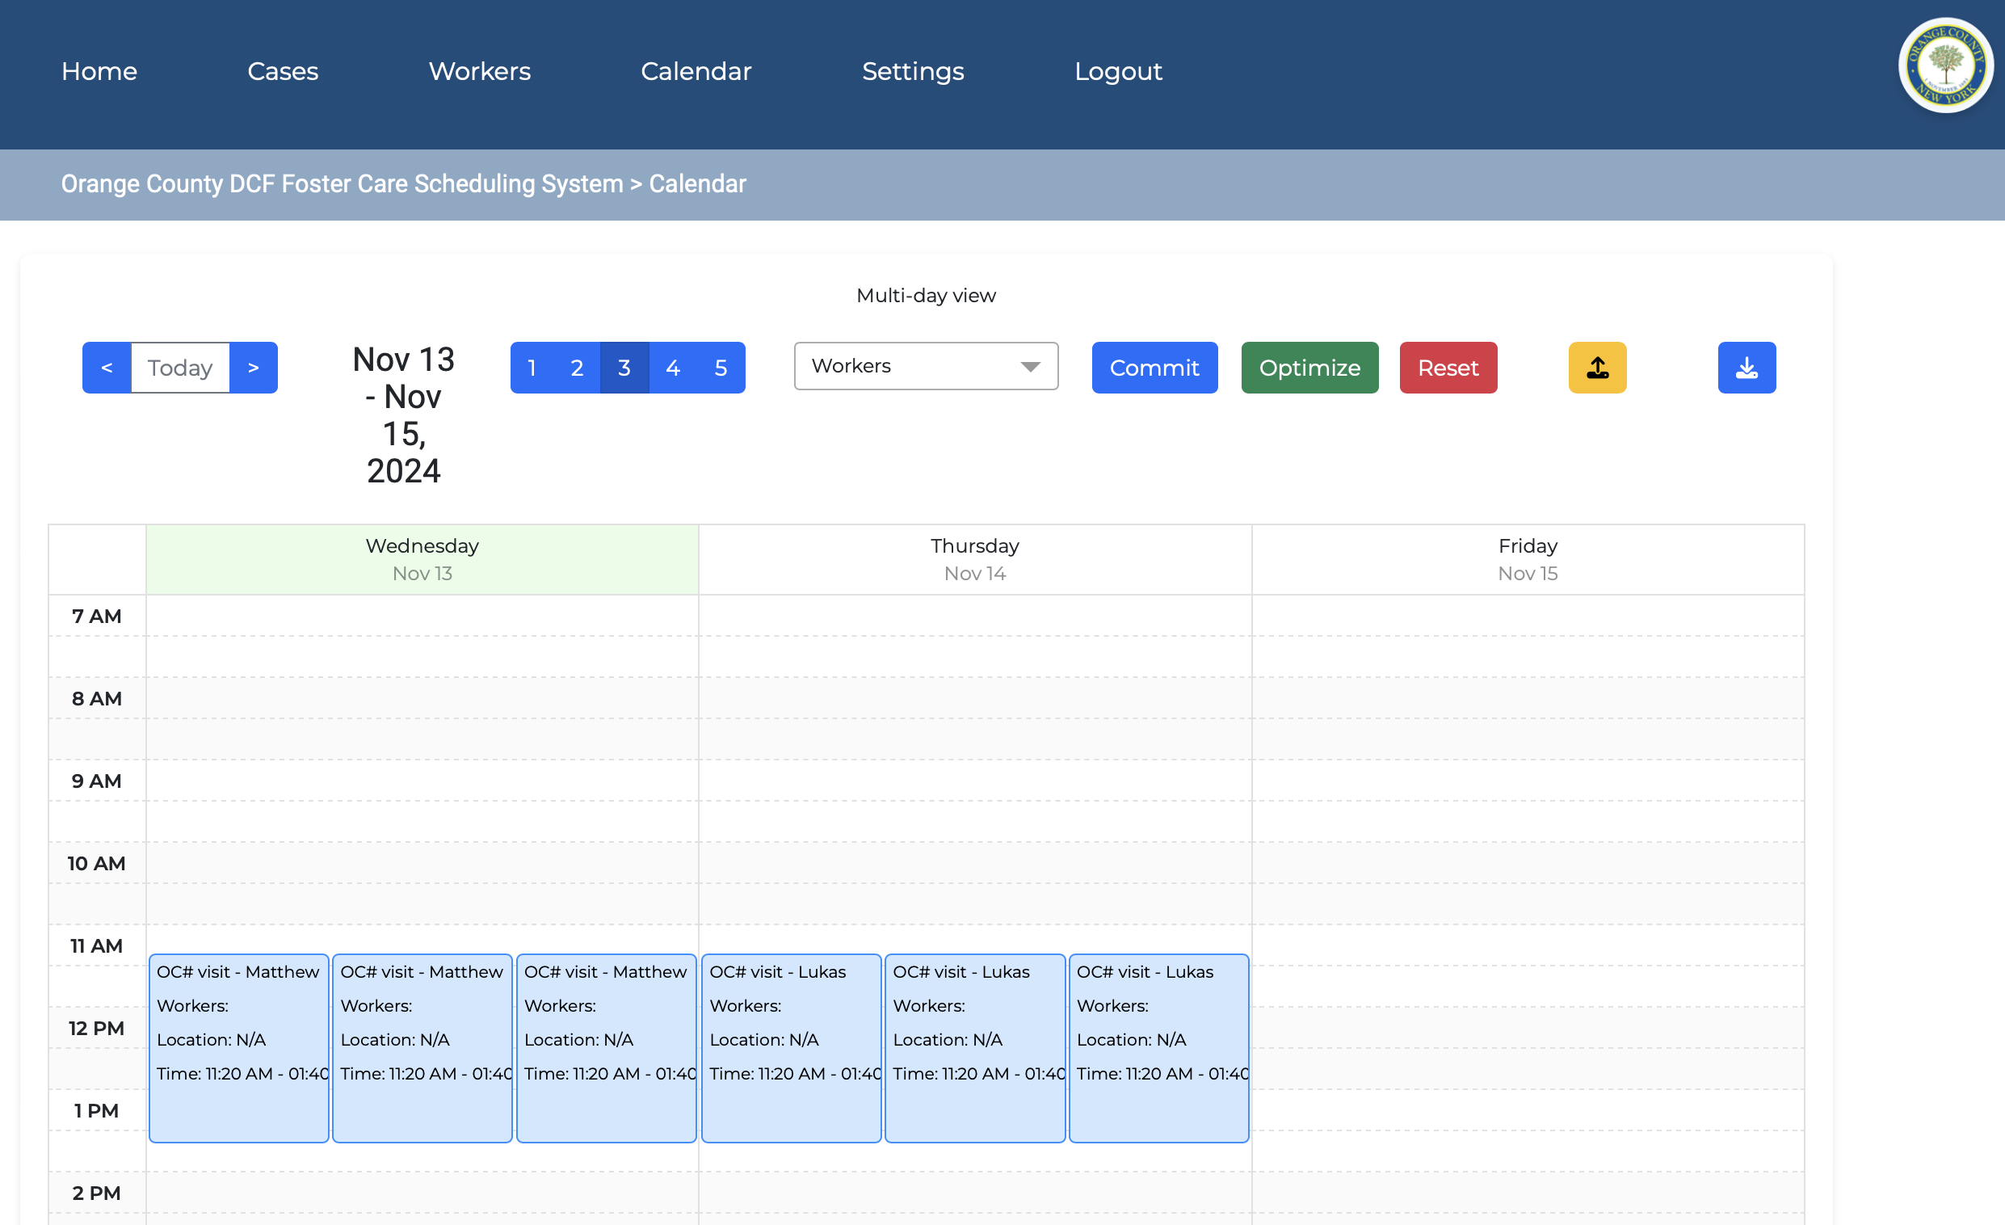
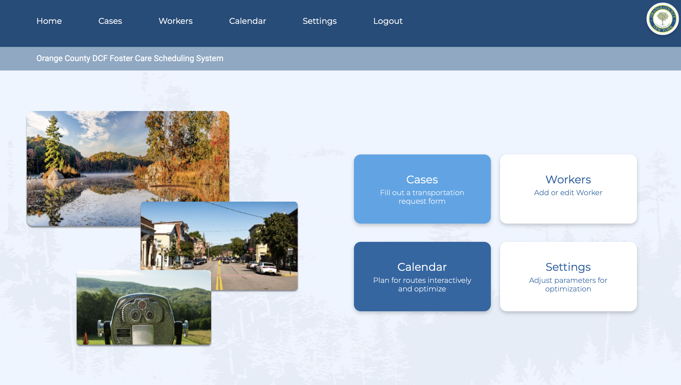
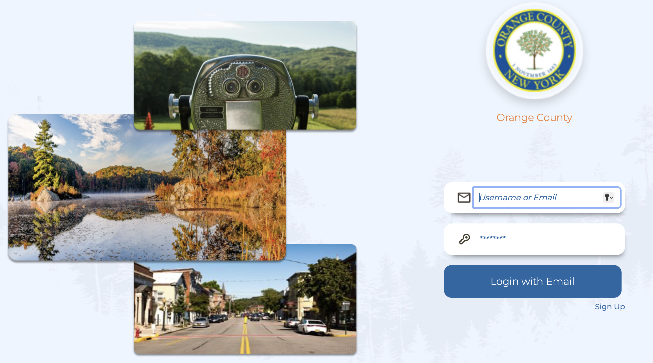
Decision Support System for Orange County
Notes:
Research question 1: DSS

Slide 6
Selective Vehicle Routing / Team Orienteering
A variant of the SVRP with multiple depots, time windows, pickups and deliveries, and site dependency
Butt and Cavalier (1994) introduced the Multiple Tour Maximum Collection Problem
(Chao et al., 1996; Vansteenwegen et al., 2011; Souffriau et al., 2013)
Branch-and-price (Boussier et al., 2007)
Branch-and-cut (Valle et al., 2011)
Surveys: (Cordeau and Laporte, 2001) and (Toth and Vigo, 2014)
Notes:
Losing non-OR people in the room.. I’ll get to Research question 2: how can we better optimize

Slide 7
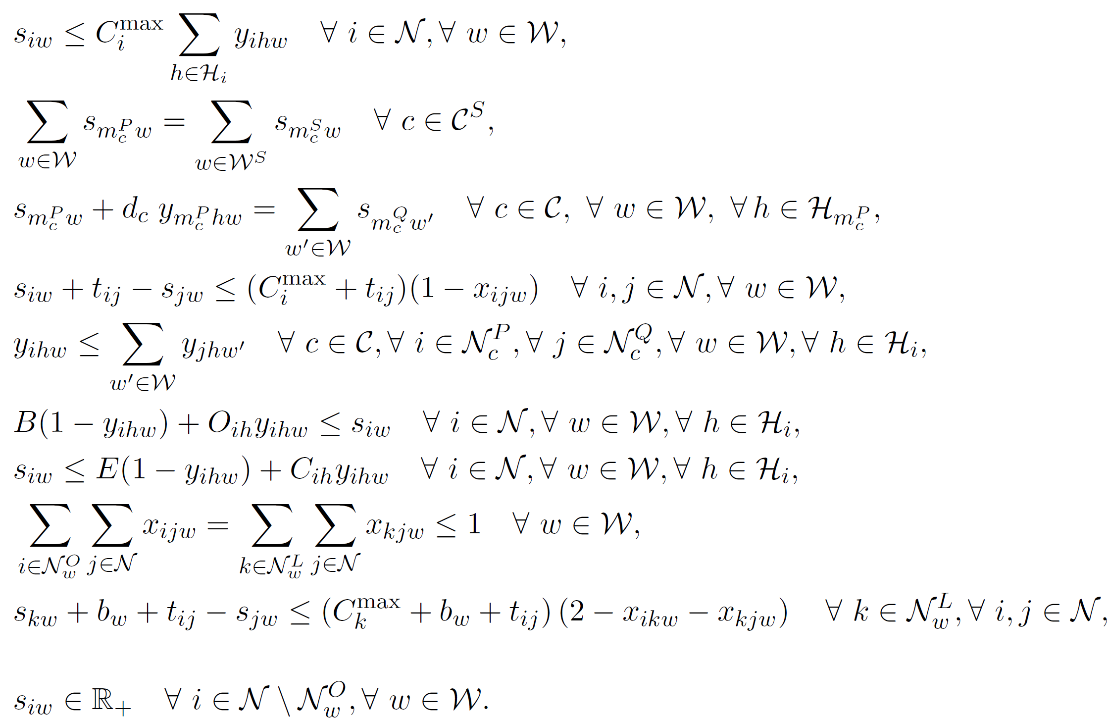
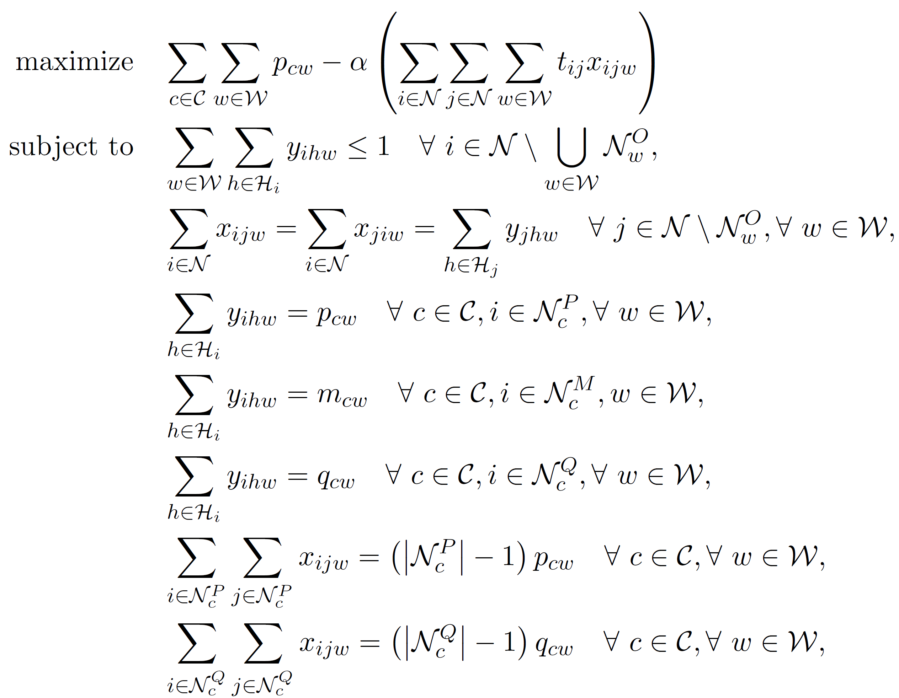
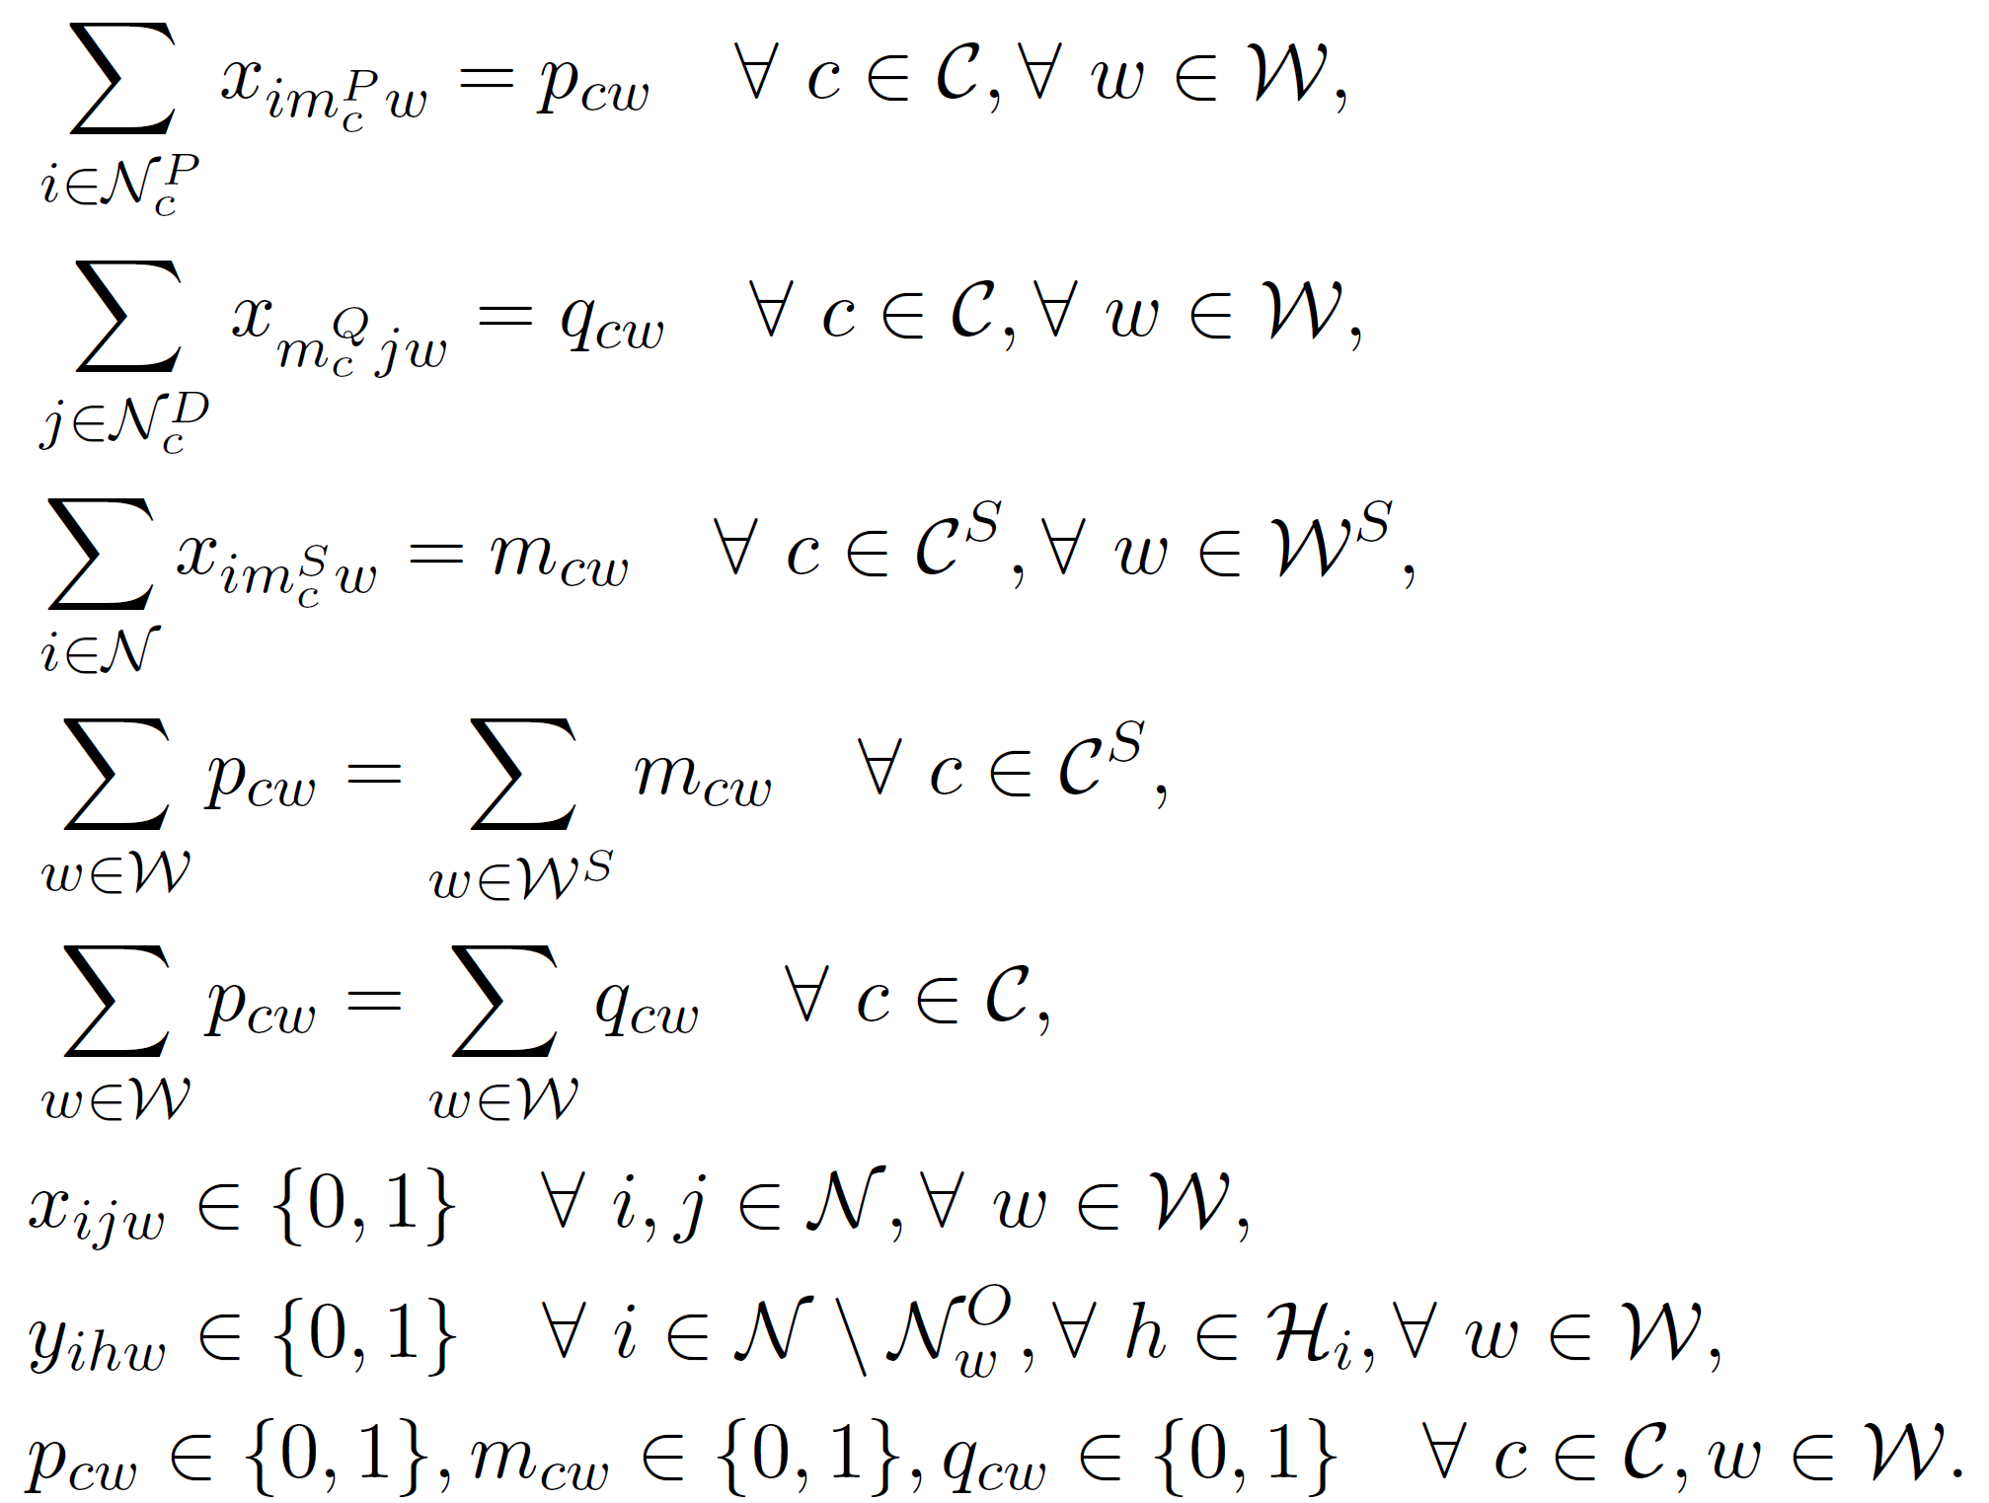
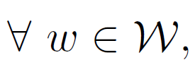
Standard Approach
Notes:
Miller–Tucker–Zemlin
Dantzig–Fulkerson–Johnson

Slide 8
Time Space Network (TSN)
A network model that combines spatial and temporal elements
Each node in the network represents a specific location at a particular time
Arcs connect nodes and represent possible transitions between locations over time
Travel
Waiting
Processing activities
Easy to implement & works well in practice
(Kliewer et al., 2006; Steinzen et al., 2010; Kliewer et al., 2012)
Discretization error
Notes:
mention the caveat

Slide 9
TSN for Foster Care Visitation
Pickup Locations
Dropoff Locations
Time
Kid1 Kid2 Kid3 Kid4 Kid1 Kid2 Kid3 Kid4

Slide 10
Refining the Framework: Model Enhancements
Arrival @ Meeting Loc
Supervision*
Case Complete @ Last Kid Drop-off Loc
Departure
preprocessed
Notes:
Note that discretization errors are less of a concern now as the entire path (a longer duration) is considered

Slide 11
Two Supervised Cases (same meeting location)
Arrival
Supervision
Departure
Case Complete

Slide 12
Addressing The Lunch Breaks
Feasible Location
Lunch Complete
Feasible Interval

Slide 13
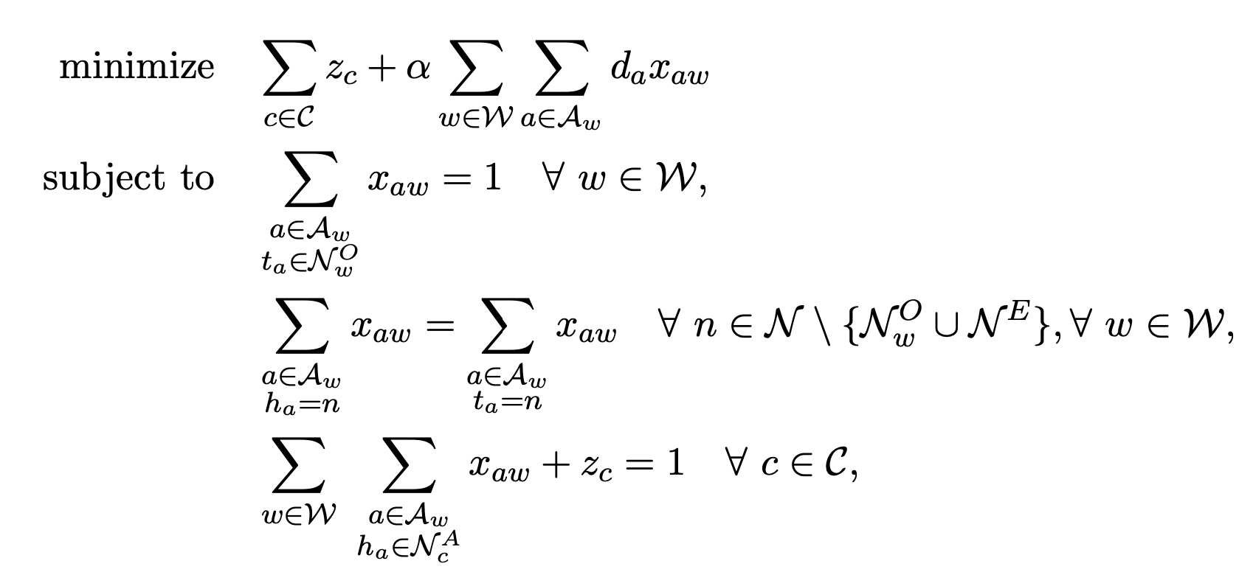
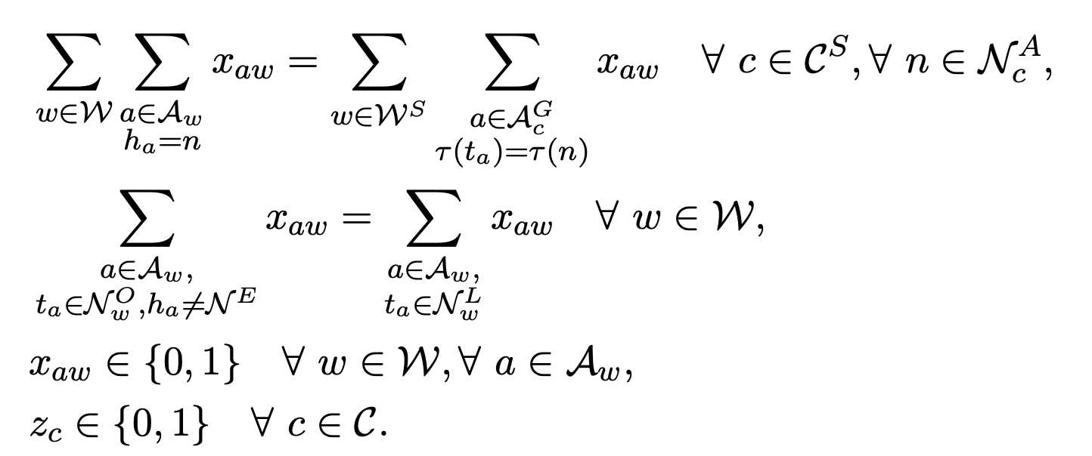
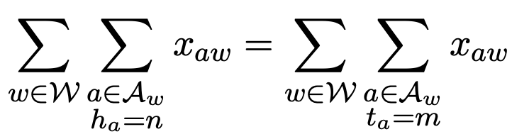
Mathematical Model
Notes:
Total number of unvisited cases, while favoring shorter paths Each worker is dispatched once
Flow conservation is preserved at each node for each worker
Each case is visited at most once during the planning period
Dropoff event starts without delay if and only if pickup event ends
If a supervised meeting takes place, a supervisor must be present in meeting location
Each worker that has been dispatched has a lunch break

Slide 14
Numerical Results
Dataset: Orange County, NY
Meeting duration: Ranging from 30 to 180 minutes
Time interval: 10, 15 and 30 minutes
Number of cases: up to 80
Number of workers: 5, 10, 15, 20
Lunch break: 1 hour, sometime between 11:00 AM and 1:30 PM
Persistence: 95% of total cases must be serviced by assigned workers
Notes:
Department of Social Services

Slide 15
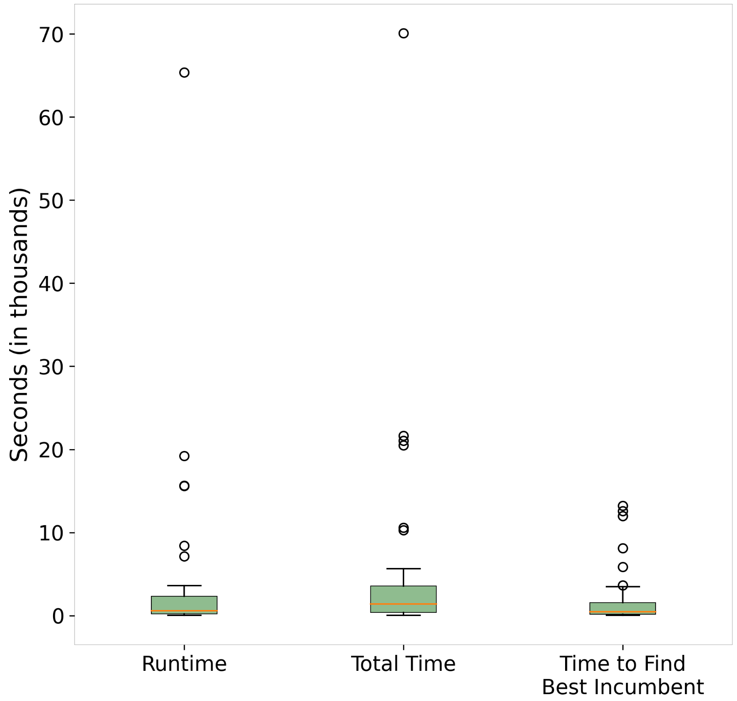
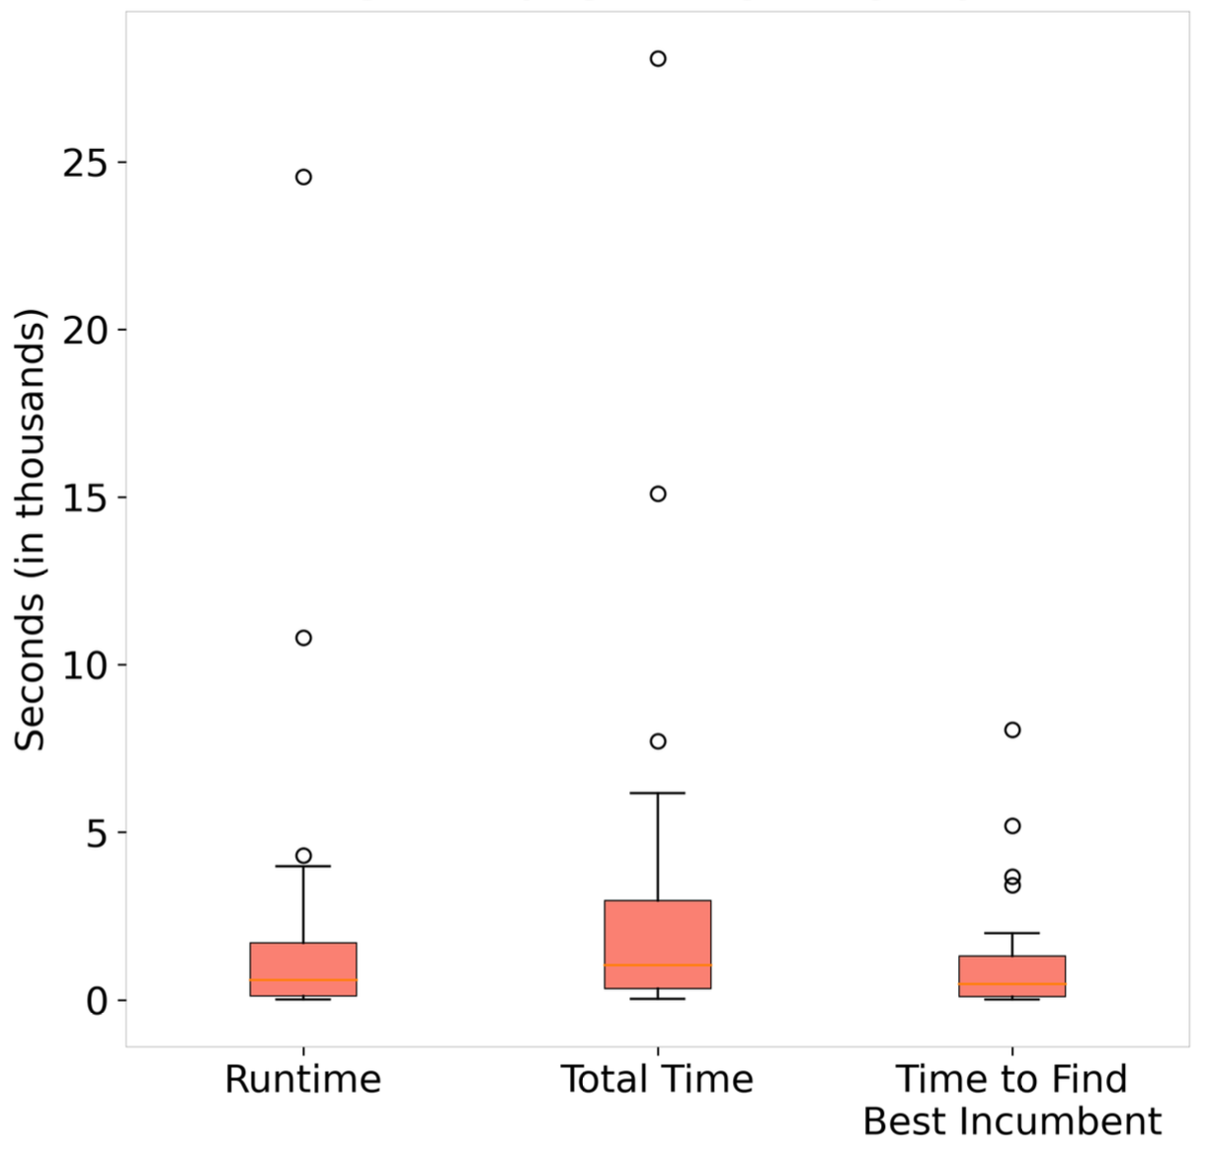
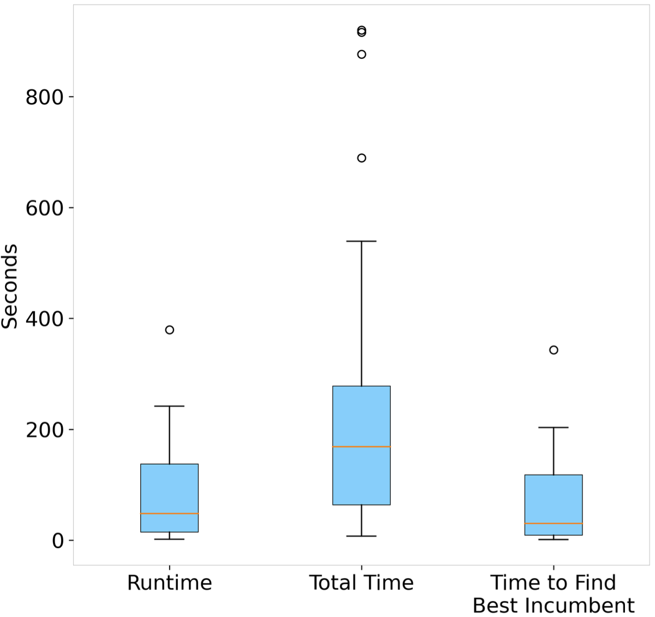
Solution Time for Daily Plan (GUROBI 10.0)
30 minute
discretization
15 minute
discretization
10 minute
discretization

Slide 16
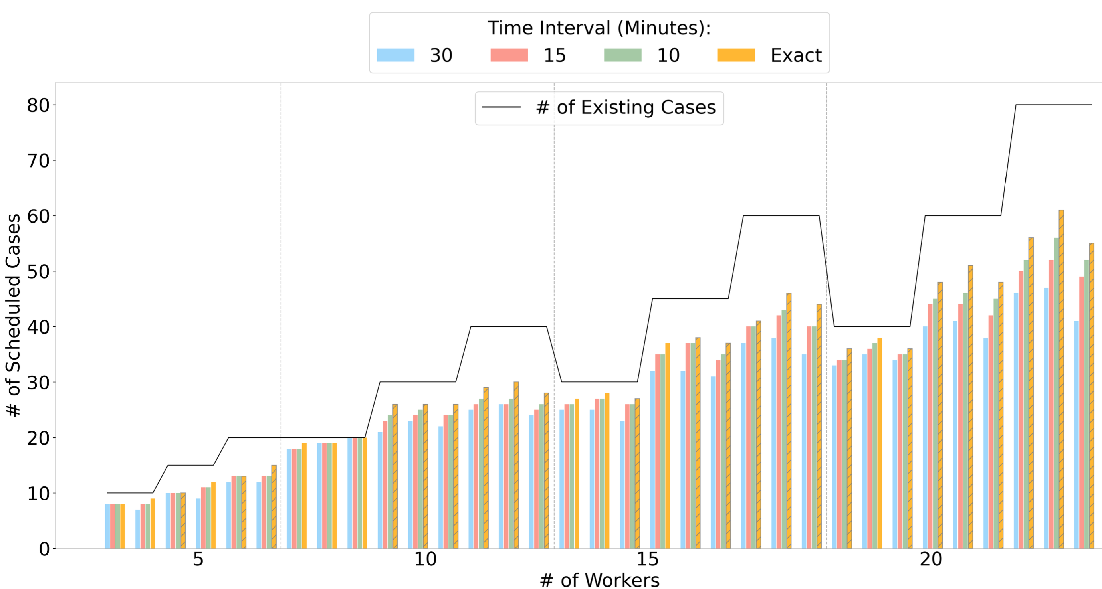
Workforce Limitations for 1 Day
Notes:
Research question 3: workforce related
80 cases a week has to be seen
Observe most are complete in a day
Using the SVRP formulation, around 50% of the instances are solved with an optimality gap of less than 8% within a 24-hour time limit.
Remember they don’t have Gurobi though

Slide 17
Remarks
Introduce Foster Care Visitation Scheduling Problem (FCVSP)
Construct a novel time-space network characterization of the FCVSP
Propose an integer optimization formulation over the network
Time-space model validated with real data and shows practical performance
Develop a cutting-edge web-based decision support tool
Notes:
albeit with granularity concerns
CBC solver is used

Slide 18
Q&A
Erhun Kundakcıoğlu
https://erhun.me
Thanks to Orange County Department of Social Services:
Debbie Pesola, Madeline Rispoli, Nicole Rodriguez

Slide 19
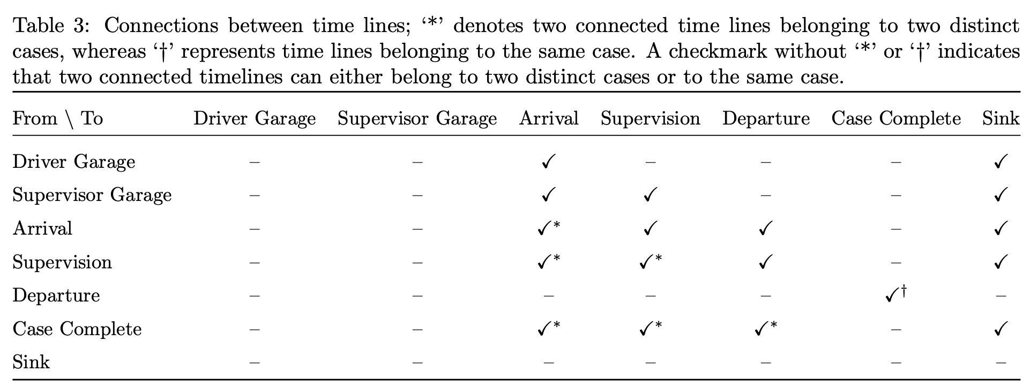
Notes:
Asterisk dagger

